Slide 1

DATABASE SYSTEMS (EIE36E): Query optimization and database performance
Doc. Ing. Václav Vostrovský Ph.D.
Ing. Petr Hanzlík

Slide 2

Outline > Database performance
Different ways of selecting data
Query processing
SQL Tuning
Simple things to do

Slide 3
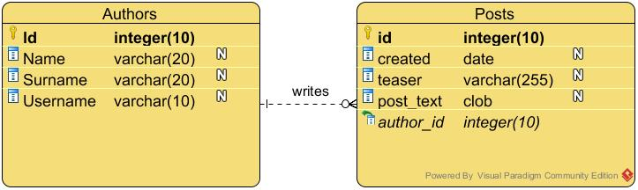
Select data from multiple tables
Let’s select all the authors, who has written at least on post before!
Notes:
CREATE TABLE Authors (id Number(10,0) PRIMARY KEY, name varchar(40), surname varchar(30), username varchar(30));
CREATE TABLE Posts (id Number(10,0) PRIMARY KEY, created DATE, author_id Number(10,0), post_text CLOB, FOREIGN KEY (author_id) REFERENCES authors(id));
VARCHAR // only up to 4000 bytes
INSERT INTO Authors VALUES (1, 'Johan', 'Bach', 'JB');
INSERT INTO Authors VALUES (2, 'Antonio', 'Vivaldi', 'Anthony');
INSERT INTO Authors VALUES (3, 'Wolfgang', 'Mozart', 'Wolfi');
INSERT INTO Authors VALUES (4, 'Antonin', 'Dvorak', 'TonyD');
INSERT INTO Posts VALUES (1, current_date, 1, 'How do you turn this on?');
INSERT INTO Posts VALUES (2, current_date, 2, 'A CLOB (Character Large Object) is an Oracle data type');
INSERT INTO Posts VALUES (3, current_date, 2, 'SYSDATE returns the current date and time set for the operating system on which the database resides.');
INSERT INTO Posts VALUES (4, current_date, 3, 'This section discusses the different types of Oracle Text indexes, their structure, the indexing process, and limitations.');

Slide 4
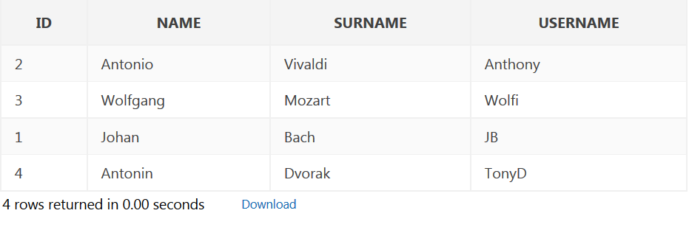
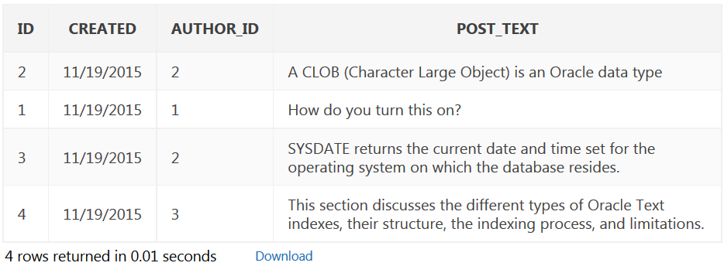
Select data from multiple tables
Notes:
INSERT INTO Authors VALUES (1, 'Johan', 'Bach', 'JB');
INSERT INTO Authors VALUES (2, 'Antonio', 'Vivaldi', 'Anthony');
INSERT INTO Authors VALUES (3, 'Wolfgang', 'Mozart', 'Wolfi');
INSERT INTO Authors VALUES (4, 'Antonin', 'Dvorak', 'TonyD');
INSERT INTO Posts VALUES (1, current_date, 1, 'How do you turn this on?');
INSERT INTO Posts VALUES (2, current_date, 2, 'A CLOB (Character Large Object) is an Oracle data type');
INSERT INTO Posts VALUES (3, current_date, 2, 'SYSDATE returns the current date and time set for the operating system on which the database resides.');
INSERT INTO Posts VALUES (4, current_date, 3, 'This section discusses the different types of Oracle Text indexes, their structure, the indexing process, and limitations.');

Slide 5
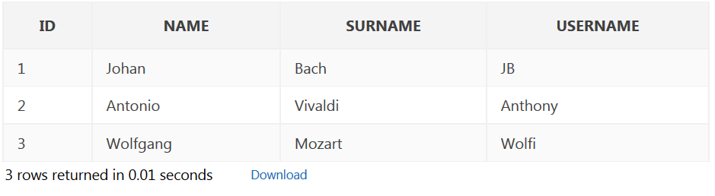
Data from multiple tables: Method 1
SELECT + foreign key/primary key match in WHERE
SELECT DISTINCT a.*
FROM Authors a, Posts p
WHERE a.id = p.author_id;
Notes:
Do not forget to turn autocommit off!

Slide 6
Data from multiple tables: Method 2
SELECT + JOIN
SELECT DISTINCT a.*
FROM authors a INNER JOIN posts p
ON a.id = p.author_id;
Notes:
Do not forget to turn autocommit off!

Slide 7
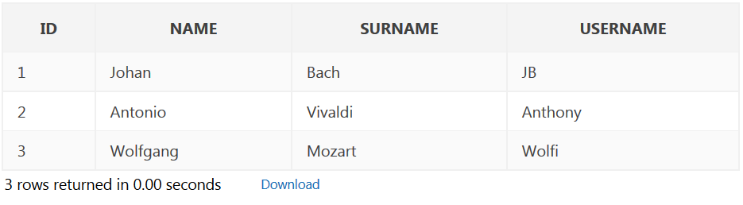
Data from multiple tables: Method 3
Nested queries
SELECT * FROM Authors
WHERE id IN (
SELECT author_id FROM posts GROUP BY author_id)
Notes:
Do not forget to turn autocommit off!

Slide 8
Query processing
Please note: SQL is a declarative language – it depicts the desired problem solution, not the path!
Is it possible to find a difference between individual approaches?

Slide 9
Query processing
Query is processed in 4 general steps:
Scanning and Parsing
Execution strategy planning
Query Code Generator
Execution in the runtime database processor

Slide 10
Scanning and Parsing
Scanning converts the query into compact tokenized representation (tree form)
Parser checks the resulting representation for correct syntax
structure of query
existence of db objects used
keywords

Slide 11
Execution strategy planning
Each operation in the query can be implemented using one or more different execution plans (access routines).
In order to execute query fast, these plans needs to be compared.

Slide 12
Query optimizer
Query optimizer is a built-in software that determines a reasonably efficient way to execute a SQL statement.
Cost based optimization
= several execution plans are directly compared, the most efficient one is selected
Heuristic optimization
= heuristic rules for reordering steps

Slide 13
Query code generator
Determined access routine is interpreted and passed to the runtime database.
The access routine can also be compiled and stored for further use!

Slide 14
SQL Tuning
SQL Tuning is the interative process of improving SQL statement performance to meet specific goal, which are measurable and achievable.
Purpose:
Fixes problems in existing application (database)
Reduce response time
Improve throughput (resource consumption)

Slide 15
General recommendations
1) Employ proper db design techniques
Use appropriate data types
Normalize first, denormalize based on benchmarking/profiling results, e.g. denormalize when performance demands it.
Don’t overuse artificial primary keys

Slide 16
General recommendations
2) Benchmarking
Simulate high stress situation with the help profiling tools (SysBench, ab, etc.)
3) Profiling
Log what resources are spent and where in order to identify specific problems in configuration.

Slide 17
General recommendations
4) Indexes
If a select is issued on an column with no index, every row must be scanned to compare with the condition. Index (usually a Binary-tree) makes search much faster.
+ Good for read operations
Indexes consumes memory space
Write operations must update index (= take longer)

Slide 18
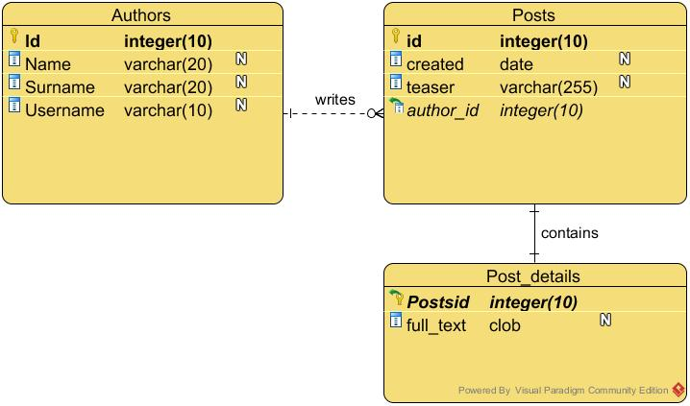
General recommendations
5) Partition your tables
Only a few columns are often used in queries. Separating unused data can lead to more efficient caching.

Slide 19
General recommendations
6) Understand the DBMS engine used
Different db engines have different general purpose, thus are fit for different tasks (see MyISAM vs InnoDB in MySQL)
7) DBMS specific extensions
Can help to improve performance in many specific situation (e.g. GIS oriented MySQL).

